Slide 1
Golang and Swagger
Less is more in code generation
Vincent van der Weele
18 August 2017

Slide 2
≠
Correction

Slide 3
Go is great for HTTP-based micro-services
Model file
Router file
Main file
Business logic
All models used in the public interface
Simple type system
Primitives
Structs
Arrays
List all endpoints
Parse HTTP inputs
Format HTTP outputs
Bootstrapping
Dependency injection
One or more packages
Typically still very simple

Slide 4
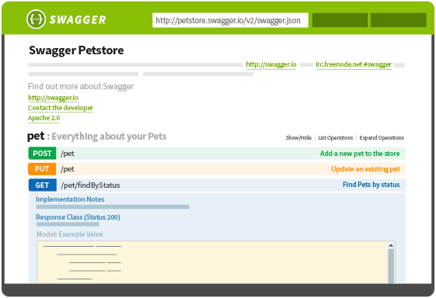
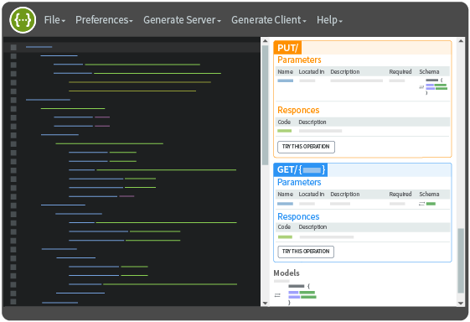
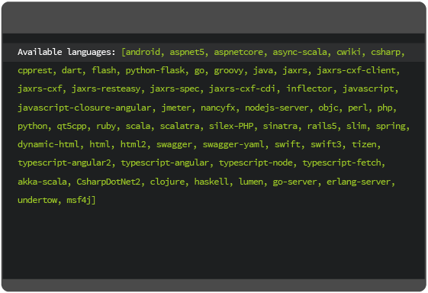
Swagger is a standard way to describe your API
Document with Swagger UI
Design with swagger editor
Build with swagger codegen

Slide 5
Main parts of a Swagger specification
Definitions
Paths
Validations
Describes the data objects that can be used in the API
primitives, objects, arrays
Describes the existing paths and their data contracts
Adds simple restrictions to input and output data
Model
Router
?

Slide 6
Existing Go generators are suboptimal
Swagger codegen
Resulting code is full of errors
Generator is written in Java
Go Swagger
Everything is configurable
5 files per endpoint and model type

Slide 7
Quick Demo

